Slide 1
Machine Learning AIML CZG565
Linear Models for Classification
Dr. Sugata Ghosal
sugata.ghosal@pilani.bits-pilani.ac.in

Slide 2

Machine Learning
Disclaimer and Acknowledgement
The content for these slides has been obtained from books and various other source on the Internet
I here by acknowledge all the contributors for their material and inputs.
I have provided source information wherever necessary
I have added and modified the content to suit the requirements of the course
Additional Sources: “Probabilistic Machine Learning, An Introduction”, Kevin P. Murphy, Contributors from BITS Pilani : Prof. Chetana, Prof.Sugata, Prof.Monali, Prof. Raja vadhana , CS109 and CS229 stanford lecture notes and many others who made their course materials freely available online.

Slide 3
Agenda
Discriminant Functions
Probabilistic Generative Classifiers
Probabilistic Discriminative Classifiers
Logistic Regression
Applications : Text classification model, Image classification

Slide 4
Decision Theory & Classification Models

Slide 5
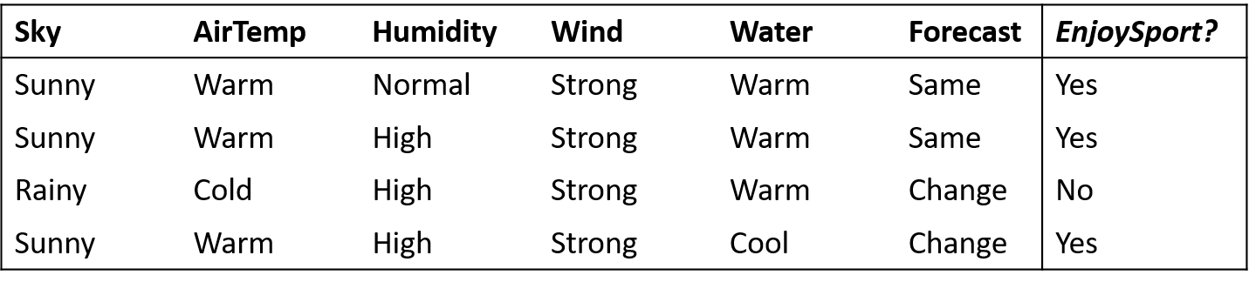
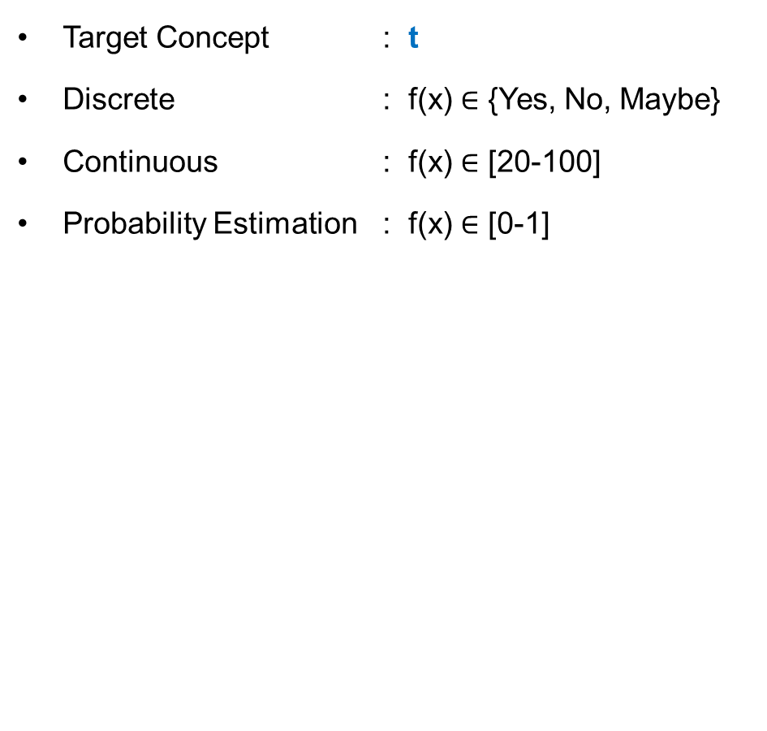
Inductive Learning Hypothesis : Interpretation
Target Concept : t
Discrete : f(x) $∈$ {Yes, No, Maybe}
Continuous : f(x) $∈$ [20-100]
Probability Estimation : f(x) $∈$ [0-1]
Classification
Regression

Slide 6
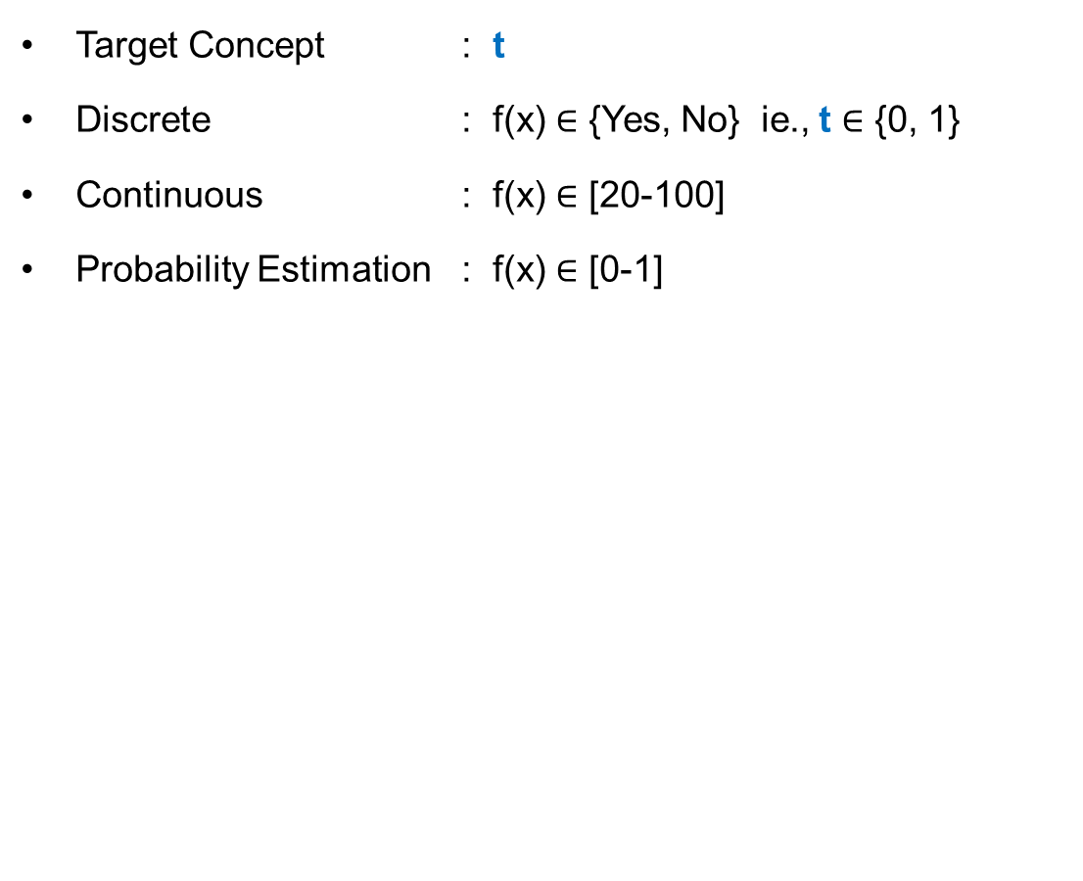
Decision Theory
Target Concept : t
Discrete : f(x) $∈$ {Yes, No} ie., t $∈$ {0, 1}
Continuous : f(x) $∈$ [20-100]
Probability Estimation : f(x) $∈$ [0-1]
Binary Classification

Slide 7
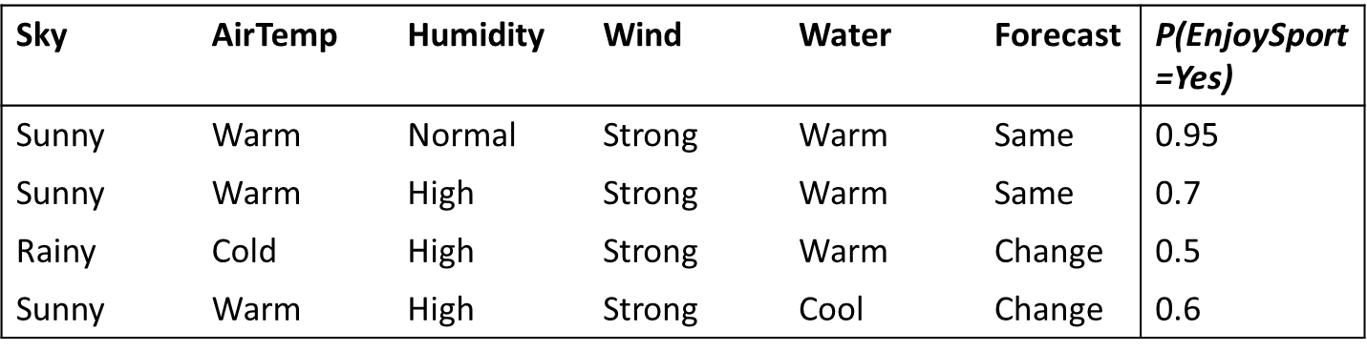
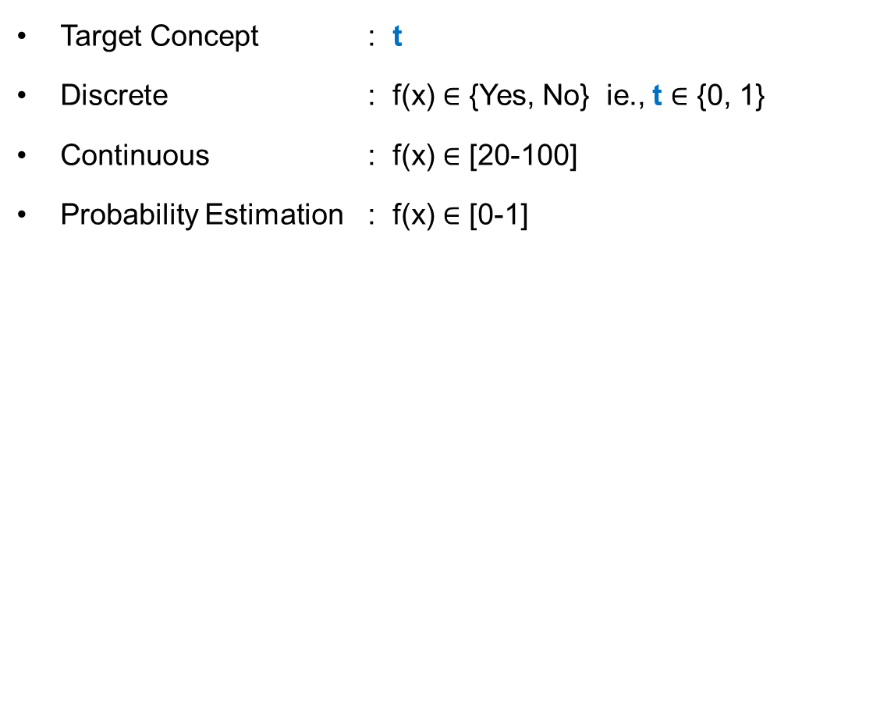
Decision Theory : The decision problem: given x, predict t according to a probabilistic model p(x, t)
Target Concept : t
Discrete : f(x) $∈$ {Yes, No} ie., t $∈$ {0, 1}
Continuous : f(x) $∈$ [20-100]
Probability Estimation : f(x) $∈$ [0-1]
p(x, C_{k}) is the (central!) inference problem
X =< , , , , , > → = P(C_{k}| X)

Slide 8

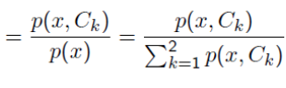
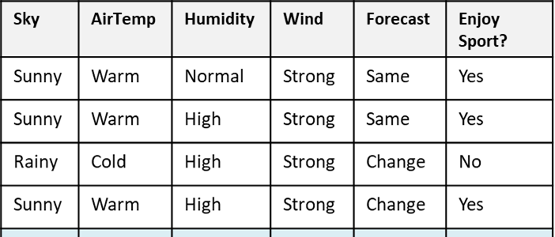
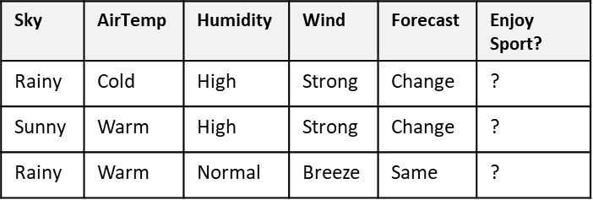
Classification Problem: Stages
Learning
algorithm
Induction/ Inference step
Learn
Model for
p(x,C_{k})
Training Set
Model
Apply Model to find
optimal t
Deduction/
Decision Step
Test Set

Slide 9
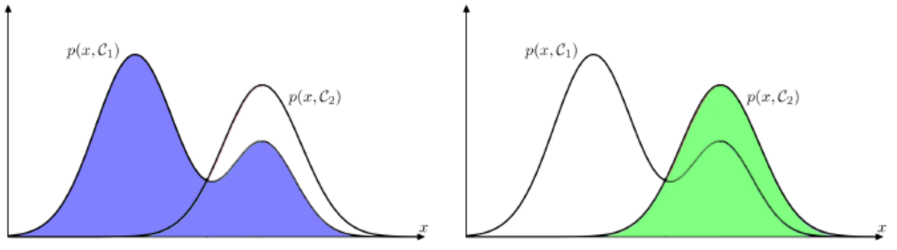
Decision Region
Model divides the input space into regions R_{k} called decision regions, one for each class, such that all points in R_{k} are assigned to class C_{k}
Learning
algorithm
A mistake occurs when an input vector belonging to class C₁ is assigned to class C₂
Induction/ Inference step
Learn
Model for
p(x,C_{k})
Training Set
Model

Slide 10
Misclassification Rate
To minimize p(mistake), each x is assigned to whichever class has the smaller value of the integrand
The minimum probability of making a mistake is obtained if each value of x is assigned to the class for which the posterior probability p(C_{k}|x) is largest.

Slide 11
Decision Theory - Summary

Slide 12
Linear Models for Classification

Slide 13
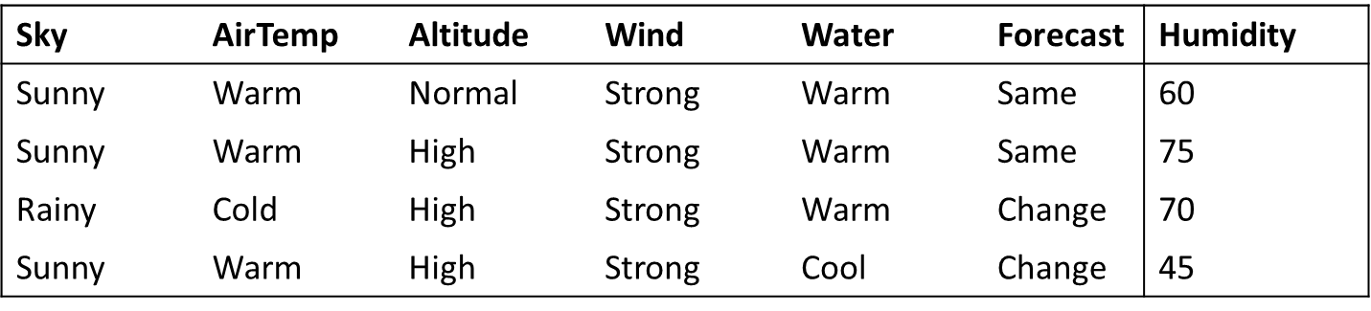
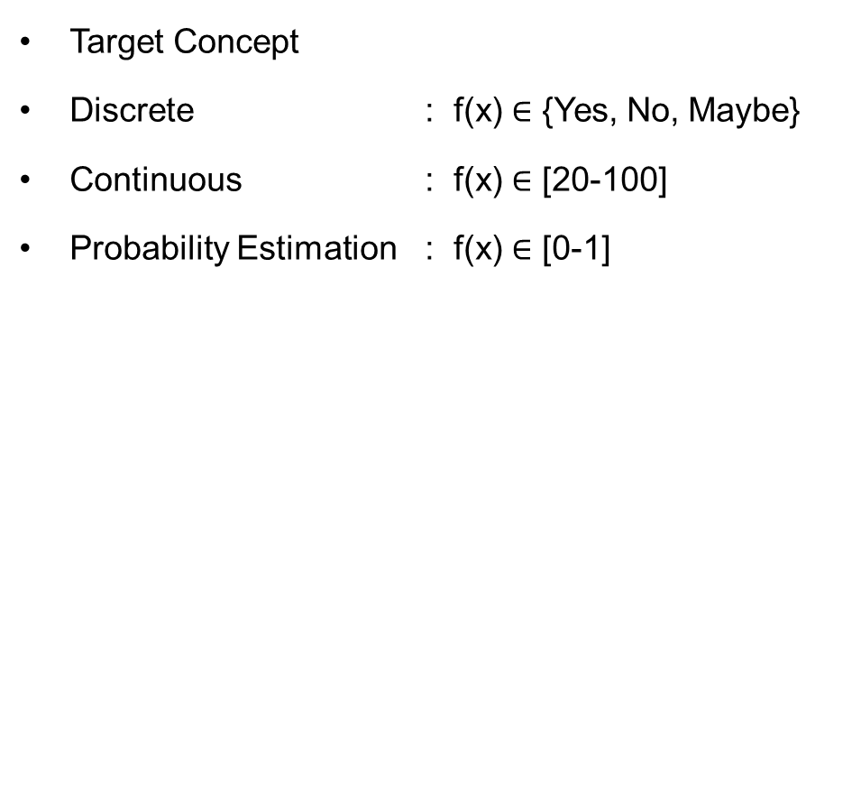
Types of Classification Inductive Learning Hypothesis : Interpretation
Target Concept
Discrete : f(x) $∈$ {Yes, No, Maybe}
Continuous : f(x) $∈$ [20-100]
Probability Estimation : f(x) $∈$ [0-1]
Classification
Regression

Slide 14
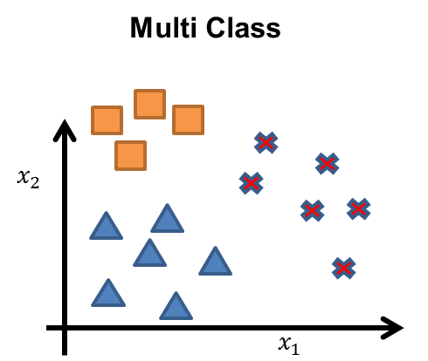
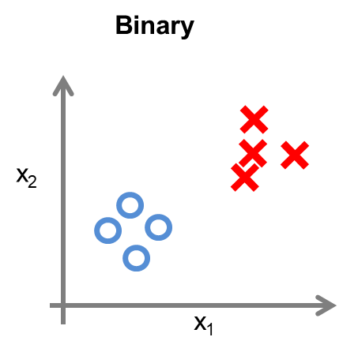
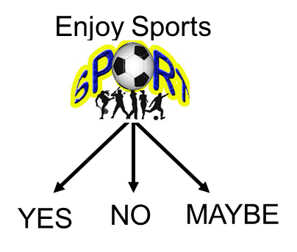
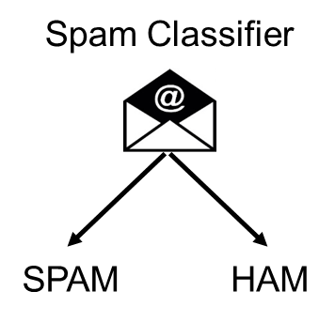
Types of Classification Output Labels
Target Concept

Slide 15
Types of Classification Output Labels
Target Concept

Slide 16
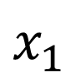
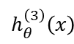
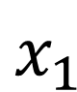
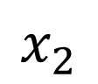
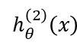
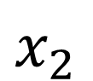
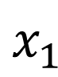
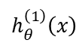
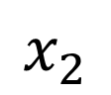
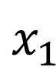

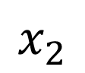
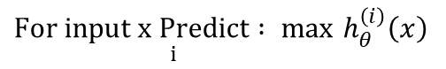
Prediction – Multi class Classification
One Vs All Strategy(one-vs-rest)
$$x_{2}$$
$$h_{θ}^{\left(1\right)}\left(x\right)$$
$$x_{1}$$
$$x_{2}$$
$$h_{θ}^{\left(2\right)}\left(x\right)$$
$$x_{2}$$
$$x_{1}$$
$$x_{1}$$
Class 1:
Class 2:
Class 3:
$$h_{θ}^{\left(3\right)}\left(x\right)$$
$$x_{2}$$
$$h_{θ}^{\left(i\right)}\left(x\right)=P\left(y=i | x;θ\right) (i=1, 2, 3)$$
$$x_{1}$$
$\underset{i}{For input x Predict : max}$ $h_{θ}^{\left(i\right)}\left(x\right)$
Note: Scikit-Learn detects when you try to use a binary classification algorithm for a multi‐class classification task, and it automatically runs OvA (except for SVM classifiers for which it uses OvO)

Slide 17
Prediction – Multi class Classification
One Vs One Strategy
$$x_{2}$$
$$h_{θ}^{\left(1\right)}\left(x\right)$$
$$x_{1}$$
$$x_{2}$$
$$h_{θ}^{\left(2\right)}\left(x\right)$$
$$x_{2}$$
$$x_{1}$$
$$x_{1}$$
Class 1:
Class 2:
Class 3:
$$h_{θ}^{\left(3\right)}\left(x\right)$$
$$x_{2}$$
$$h_{θ}^{\left(i\right)}\left(x\right)=P\left(y=i | x;θ\right) (i=1, 2, 3)$$
$$x_{1}$$
$\underset{i}{For input x Predict : max}$ $h_{θ}^{\left(i\right)}\left(x\right)$
N × (N – 1) / 2 classifiers

Slide 18
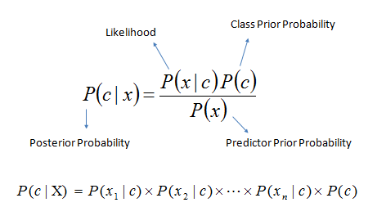
Types of Classification Decision Theory: Interpretation Model Building
Generative
x₂
x₁
Sky | AirTemp | Humidity | Wind | Forecast | Enjoy Sport?
Sunny | Warm | Normal | Strong | Same | Yes
Sunny | Warm | High | Strong | Same | No
Rainy | Cold | High | Strong | Change | No
Sunny | Warm | Normal | Breeze | Same | Yes
Sunny | Hot | Normal | Breeze | Same | No
Rainy | Cold | High | Strong | Change | No
Sunny | Warm | High | Strong | Change | Yes
Rainy | Warm | Normal | Breeze | Same | Yes
Known as generative models, because by sampling from them it is possible to generate synthetic data points in the input space.
Eg., Gaussians, Naïve Bayes, Mixtures of multinomials , Mixtures of Gaussians, Bayesian networks

Slide 19
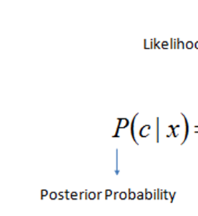
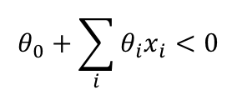
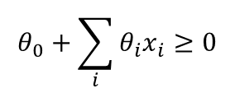
Types of Classification Decision Theory: Interpretation Model Building
Discriminative
y=1
x₂
Decision Boundary
y=0
x₁
Sky | AirTemp | Humidity | Wind | Forecast | Enjoy Sport?
Sunny | Warm | Normal | Strong | Same | Yes
Sunny | Warm | High | Strong | Same | No
Rainy | Cold | High | Strong | Change | No
Sunny | Warm | Normal | Breeze | Same | Yes
Sunny | Hot | Normal | Breeze | Same | No
Rainy | Cold | High | Strong | Change | No
Sunny | Warm | High | Strong | Change | Yes
Rainy | Warm | Normal | Breeze | Same | Yes
$$θ_{0}+\sum_{i}{{θ_{i}x}_{i}≥0}$$
$$θ_{0}+\sum_{i}{{θ_{i}x}_{i}<0}$$
Logistic regression, SVMs , tree based classifiers (e.g. decision tree) Traditional neural networks, Nearest neighbor

Slide 20
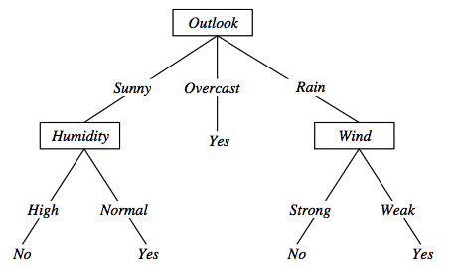
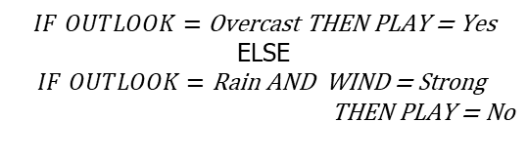
Types of Classification Decision Theory: Interpretation Model Building
Sky | AirTemp | Humidity | Wind | Forecast | Enjoy Sport?
Sunny | Warm | Normal | Strong | Same | Yes
Sunny | Warm | High | Strong | Same | No
Rainy | Cold | High | Strong | Change | No
Sunny | Warm | Normal | Breeze | Same | Yes
Sunny | Hot | Normal | Breeze | Same | No
Rainy | Cold | High | Strong | Change | No
Sunny | Warm | High | Strong | Change | Yes
Rainy | Warm | Normal | Breeze | Same | Yes
$$IF OUTLOOK=\text{Overcast} \text{THEN} \text{PLAY}\text{ = }\text{Yes}$$
ELSE
$$IF OUTLOOK=\text{Rain} \text{AND} \text{WIND}\text{ = }\text{Strong}$$
$$\text{THEN} \text{PLAY}\text{ = }\text{No}$$
Logistic regression, SVMs , tree based classifiers (e.g. decision tree) Traditional neural networks, Nearest neighbor

Slide 21
Logistic Regression

Slide 22

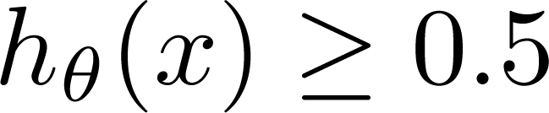
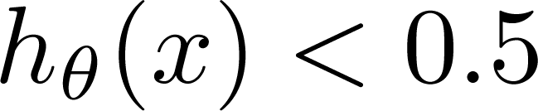
Malignant ?
Logistic Regression vs Least Squares Regression
(Yes) 1
(No) 0
Tumor Size
Can we solve the problem using linear regression? E.g., fit a straight line and define a threshold at 0.5
Threshold classifier output h_{θ}(x) at 0.5:
A Discriminant function f (x)
directly map input to class labels
In two-class problem, f (.) is binary valued
If
If
, predict “y = 1”
, predict “y = 0”

Slide 23
Decision Rules
Classifier:
f (x, w) = w_{o} + w^{T} x (linear discriminant function)
Decision rule is
Mathematically
y = sign(w₀ + w^{T} x)
This specifies a linear classifier: it has a linear boundary (hyperplane)
w₀ + w^{T} x = 0
A discriminant is a function that takes an input vector x and assigns it to one of K classes, denoted C_{k}.

Slide 24

Malignant ?
Logistic Regression vs Least Squares Regression
(Yes) 1
(No) 0
Failure due to adding a new point

Slide 25
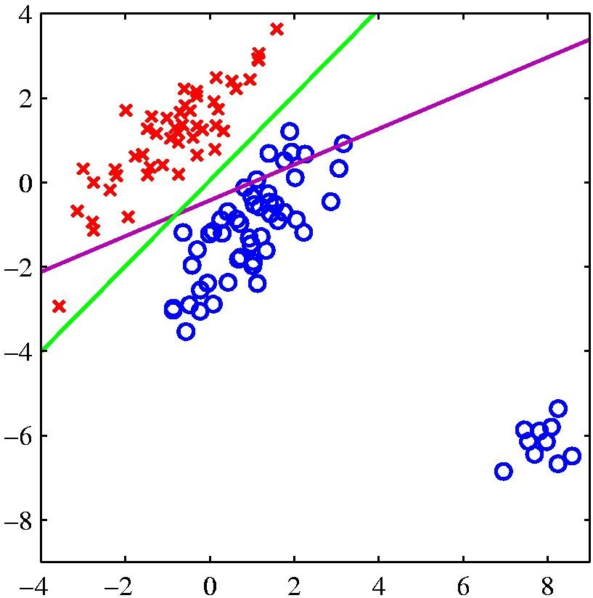
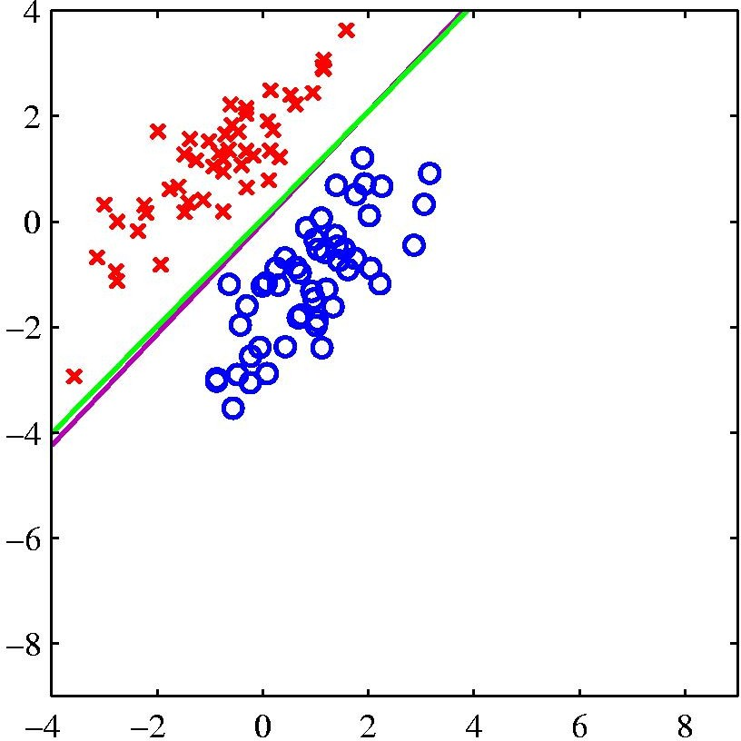
Logistic Regression vs Least Squares Regression
logistic regression
least squares regression
The right-hand plot shows the corresponding results obtained when extra data points are added at the bottom left of the diagram, showing that least squares is highly sensitive to outliers, unlike logistic regression.

Slide 26
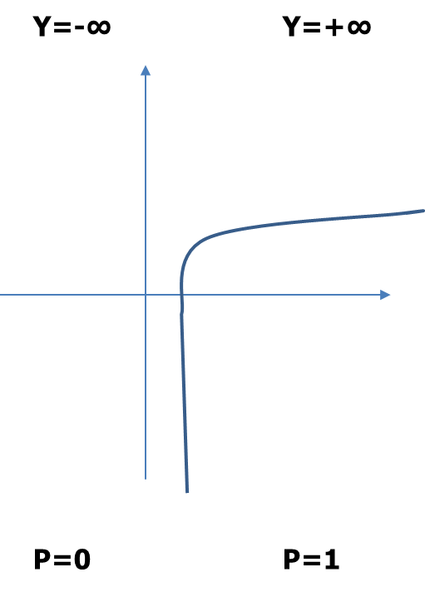
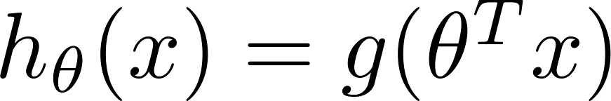
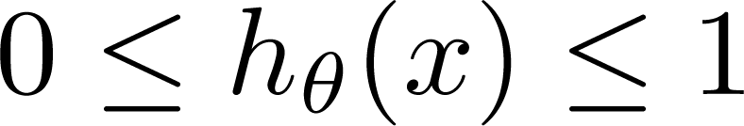
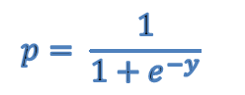
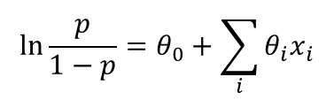
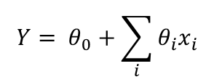
Classification: y = 0 or 1 h_{θ}(x) can be > 1 or < 0 What we need: Logistic Regression:
Logistic Regression vs Least Squares Regression
$${Y= θ}_{0}+\sum_{i}{{θ_{i}x}_{i}}$$
$${p= \frac{1}{1+e^{−y}}}_{}$$
$${\ln{\frac{p}{1−p}}=θ}_{0}+\sum_{i}{{θ_{i}x}_{i}}$$
Another drawback of using linear regression for this problem

Slide 27
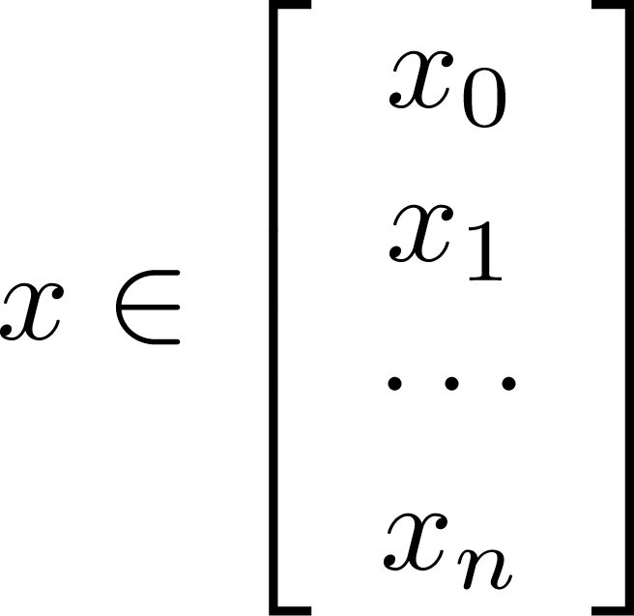
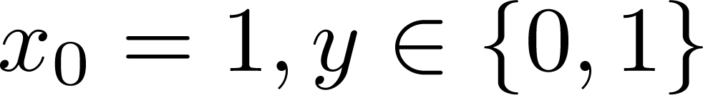
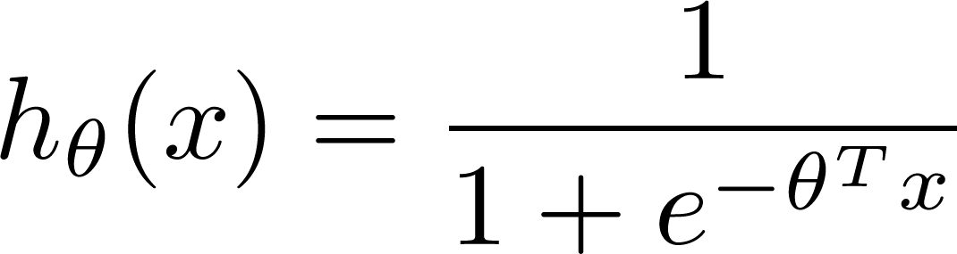
Learning model parameters
Training set:
m examples
How to choose parameters (feature weights) ?

Slide 28
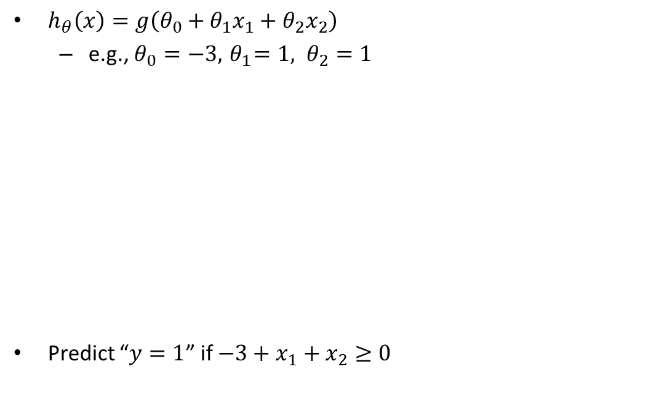
Logistic Regression
At decision boundary output of logistic regression is 0.5
$h_{θ}\left(x\right)=g\left(θ_{0}+θ_{1}x_{1}+θ_{2}x_{2}\right)$
e.g., $θ_{0}=−3, { θ}_{1}=1, θ_{2}=1$
Predict “$y=1$” if $−3+x_{1}+x_{2}≥0$
Decision boundary
Age
Tumor Size
Slide credit: Andrew Ng

Slide 29
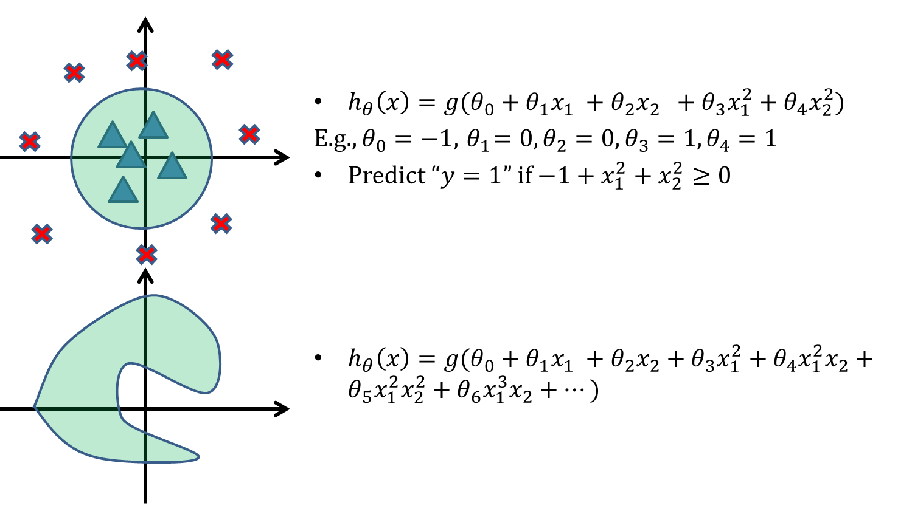
Logistic Regression
Slide credit: Andrew Ng

Slide 30

Logistic Regression
Training set:
m examples
n features
How to choose parameters (feature weights)?

Slide 31
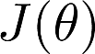
Logistic Regression
Training set:
How to choose parameters (feature weights)?
“non-convex”
“convex”

Slide 32
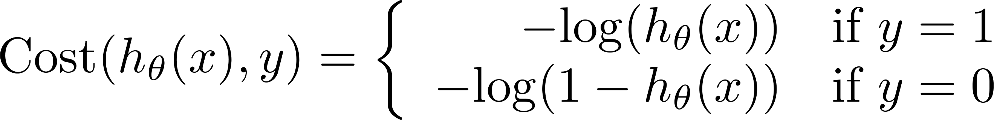


Logistic regression cost function (cross entropy)
If y = 1
Cost
0
1

Slide 33
Logistic regression cost function
If y = 0
Cost=0; If y=0 and h_{Ꝋ}(x)=0
Cost
0
1

Slide 34





Cost function
To fit parameters : Apply Gradient Descent Algorithm
To make a prediction given new :
Output :

Slide 35


Gradient Descent Algorithm
$$J\left(θ\right)=−\frac{1}{m}\left[\sum_{i=1}^{m}{y^{(i)} log\left(h_{θ}\left(x^{(i)}\right)\right)+(1−y^{(i)}) log\left({1−h}_{θ}\left(x^{(i)}\right)\right)}\right]$$
Goal: $\min_{θ}{J(θ)}$
Repeat
{
$$θ_{j}≔θ_{j}−α\frac{∂}{∂θ_{j}}J\left(θ\right)$$
}
$$\frac{∂}{∂θ_{j}}J\left(θ\right)=\frac{1}{m}\sum_{i=1}^{m}{(h_{θ}\left(x^{\left(i\right)}\right)−y^{(i)})}x_{j}^{(i)}$$

Slide 36




Gradient Descent Algorithm
Linear Regression
Repeat {
$$θ_{j}≔θ_{j}−α\frac{1}{m}\sum_{i=1}^{m}{\left(h_{θ}\left(x^{\left(i\right)}\right)−y^{(i)}\right)}x_{j}^{(i)}$$
}
$$h_{θ}\left(x\right)=θ^{⊤}x$$
Logistic Regression
Repeat {
$$θ_{j}≔θ_{j}−α\frac{1}{m}\sum_{i=1}^{m}{\left(h_{θ}\left(x^{\left(i\right)}\right)−y^{(i)}\right)}x_{j}^{(i)}$$
}
$$h_{θ}\left(x\right)=\frac{1}{1+e^{−θ^{⊤}x}}$$

Slide 37
Example: Sentiment Analysis
Sentiment Features

Slide 38
Classifying sentiment using logistic regression

Slide 39







Logistic Regression – Fit a Model
Hyper parameters:
Learning Rate = 0.3
Initial Weights = (0.5, 0.5,0.5)
Regularization Constant = 0
$θ$^{T}X = 0.5 +0.5 CGPA + 0.5 IQ
$$h_{θ}\left(x\right)=\frac{1}{1+e^{−θ^{⊤}x}}$$
$$θ_{0}≔θ_{0}−0.3\frac{1}{6}\sum_{i=1}^{6}{\left(h_{θ}\left(x^{\left(i\right)}\right)−y^{\left(i\right)}\right)}(1)$$
$$h_{θ}\left(x\right)=\frac{1}{1+e^{−(0.5 +0.5 CGPA + 0.5 IQ )}}$$
$$θ_{CGPA}≔θ_{CGPA}−0.3\frac{1}{6}\sum_{i=1}^{6}{\left(h_{θ}\left(x^{\left(i\right)}\right)−y^{(i)}\right)}x_{CGPA}^{(i)}$$
$$θ_{IQ}≔θ_{IQ}−0.3\frac{1}{6}\sum_{i=1}^{6}{\left(h_{θ}\left(x^{\left(i\right)}\right)−y^{(i)}\right)}x_{IQ}^{(i)}$$
Approx. : New weights
$θ_{0}$ = 0.4
$θ_{1=CGPA}=$-0.4
$$θ_{2=IQ }=−0.6$$

Slide 40
Logistic Regression – Inference & Interpretation
Assume : 0.4+0.3CGPA-0.45IQ
Predict the Job offered for a candidate : (5, 6)
h(x) = 0.31
Y-Predicted = 0 / No
Note :
The exponential function of the regression coefficient (e^{w-cpga}) is the odds ratio associated with a one-unit increase in the cgpa.
+ The odd of being offered with job increase by a factor of 1.35 for every unit increase in the CGPA [np.exp(model.params)]

Slide 41

Logistic regression (Classification)
Model
$h_{θ}\left(x\right)=P\left(Y=1 | X_{1},X_{2}, ⋯, X_{n}\right)=\frac{1}{1+e^{−θ^{⊤}x}}$
Cost function
$$J\left(θ\right)=\frac{1}{m}\sum_{i=1}^{m}{Cost(h_{θ}(x^{\left(i\right)}),y^{(i)}))} Cost(h_{θ}\left(x\right),y)=\left\{\begin{aligned}−log\left(h_{θ}\left(x\right)\right) if y=1 \\ −log\left({1−h}_{θ}\left(x\right)\right) if y=0\end{aligned}\right.$$
Learning
Gradient descent: Repeat {$θ_{j} ≔θ_{j}−α\frac{1}{m}\sum_{i=1}^{m}{\left(h_{θ}\left(x^{\left(i\right)}\right)−y^{\left(i\right)}\right)}x_{j}^{\left(i\right)}$}
Inference
$$\hat{Y}=h_{θ}\left(x^{test}\right)=\frac{1}{1+e^{−θ^{⊤}x^{test}}}$$
Note:
σ(t) < 0.5 when t < 0, and σ(t) ≥ 0.5 when t ≥ 0, so a Logistic model predicts 1 if xTθ is positive, and 0 if it is negative
logit(p) = log(p / (1 - p)), is the inverse of the logistic function. Indeed, if you compute the logit of the estimated probability p, you will find that the result is t. The logit is also called the log-odds

Slide 42

Overfitting vs Underfitting
Overfitting
Underfitting
Fitting the data too well
Features are noisy / uncorrelated to concept
Learning too little of the true concept
Features don’t capture concept
Too much bias in model

Slide 43
Regularization Note : This topic is already covered in the module 3 . Refresher & few more points added here

Slide 44

Regularization

Slide 45


Ways to Control Overfitting
Regularization
$$Loss\left(S\right)=\sum_{i}^{n}{Loss(y_{i}^{^},y_{i})}$$
$$+ α\sum_{j}^{\# Weights}{|{\text{θ}}_{j}|}$$
Note:
The hyperparameter controlling the regularization strength of a Scikit-Learn LogisticRegression model is not alpha (as in other linear models), but its inverse: C. The higher the value of C, the less the model is regularized.

Slide 46

Regularization

Slide 47

Understanding Regularization

Slide 48


Regularization
Ridge Regression / Tikhonov regularization

Slide 49



Regularization
Lasso Regression (Least Absolute Shrinkage and Selection Operator Regression)

Slide 50
Thank you !
Required Reading for completed session :
T1 - Chapter # 6 (Tom M. Mitchell, Machine Learning)
R1 – Chapter # 3,#4 (Christopher M. Bhisop, Pattern Recognition & Machine Learning) & Refresh your MFDS course basics
Next Session Plan : Module 5 – Decision Tree Classifier

